Slide 1

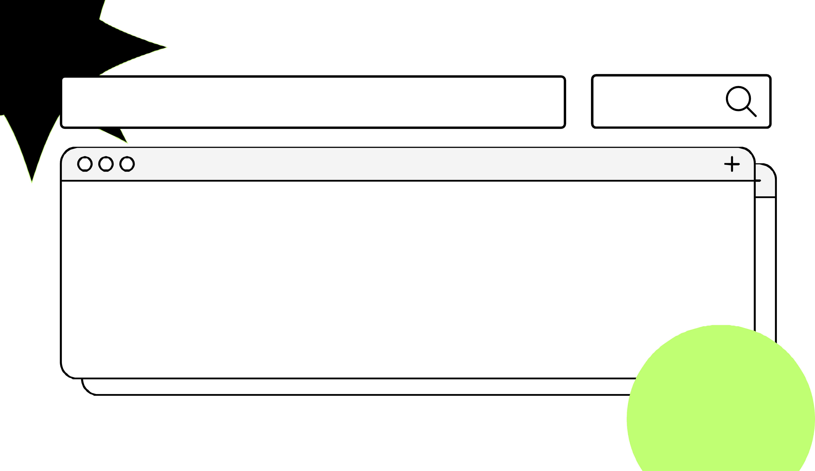
Design Pattern
Search
Proxy
Truong Dang Minh Khue

Slide 2
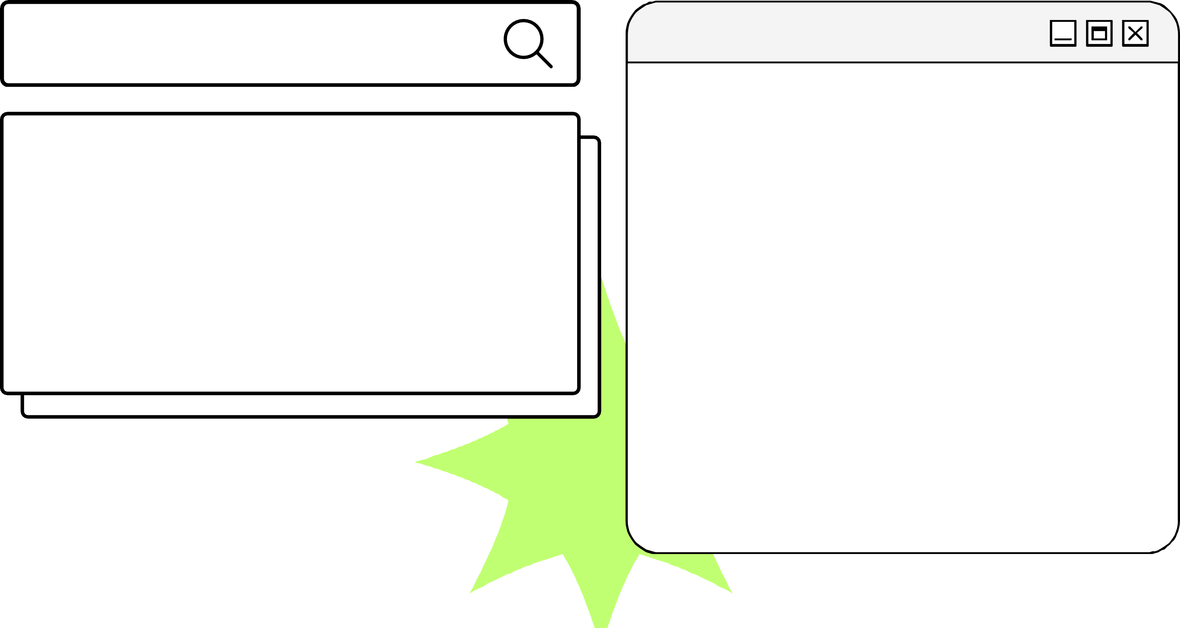
Definition
provides a surrogate or placeholder for another object to control access to it.
Proxy Pattern

Slide 3
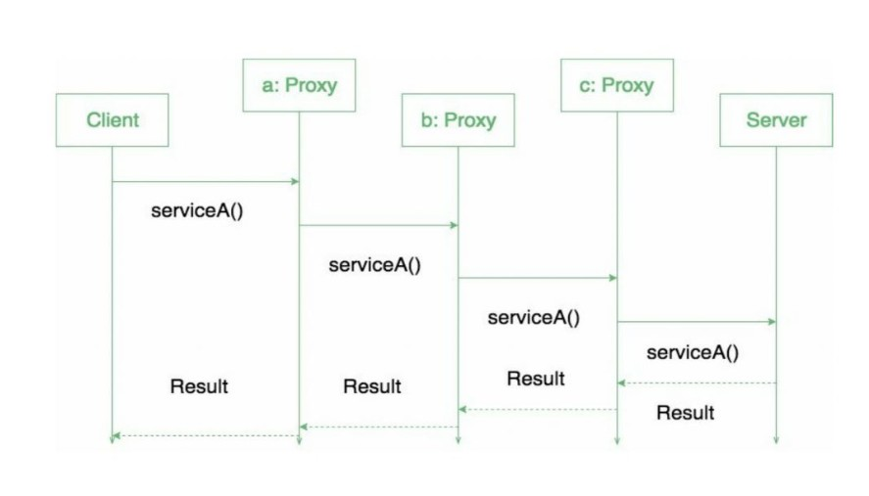


Slide 4
Advantages
of using proxy pattern
1
2
3
Security
This pattern avoids duplication of objects that can be large and memory-intensive
The remote proxy also ensures security by installing the proxy code locally (stub) in the client and then accessing the server with the help of the remote code.

Slide 5
Thank you!
Until our next design pattern!

